Slide 1

Computer Organization
Lab4
Group9

Slide 2
01
Design Target
Contents
02
Design Process
03
Design Truth Table

Slide 3
01
Design Target

Slide 4
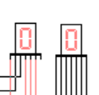
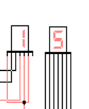
Design Target
Design a 4-bit binary counter system
Displays numbers ranging from 00 to 15
Using two seven-segment displays

Slide 5
02
Design Progress

Slide 6
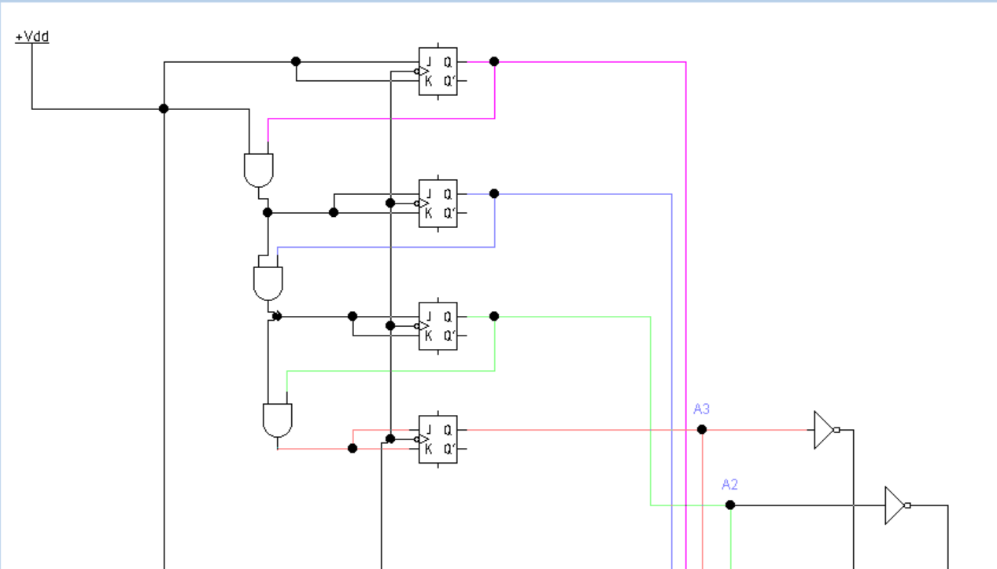
Design Progress——Key Components
Key System Components —— 4-bit binary counter
Composed of four JK flip-flops.
Generates a 4-bit binary output
(A3, A2, A1, A0), representing numbers
from 0 to 15.

Slide 7
Design Progress——Key Components
Key System Components —— 7-segment display
Units Display:
Displays values from 0 to 9 to represent the units digit of the counter value.
Driven by decoded signals (Sa, Sb, Sc, Sd, Se, Sf, Sg) generated from the
4-bit counter output (A3, A2, A1, A0).
Tens Display:
Displays values of 0 or 1 to represent the tens digit of the counter value.
Controlled by signal N, indicating whether the current value exceeds 9.

Slide 8
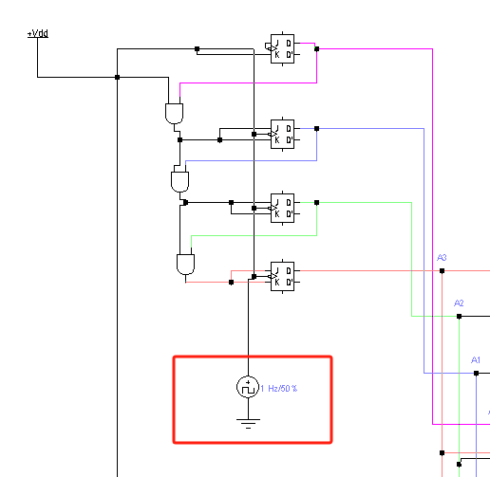
Design Progress——Key Components
Key System Components —— clock
we connect the output of the clock to the clock input of the counter. The counter will increase by 1 at every clock cycle.
We set the clock in “1Hz/50%”, which means the frequency is 1 time/s and the duty cycle is 50%

Slide 9
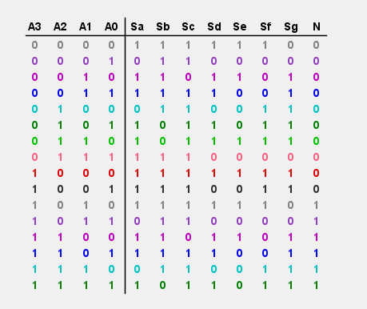
Design Progress—— Truth Table

Slide 10
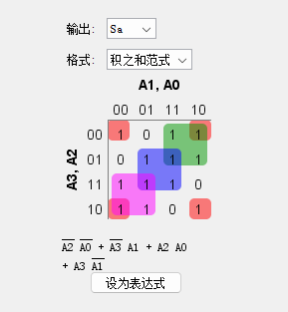
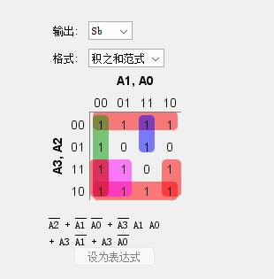
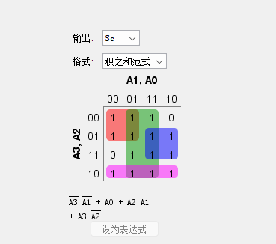
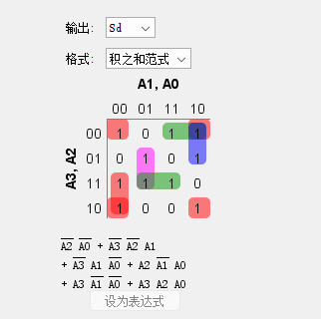
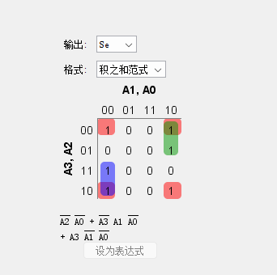
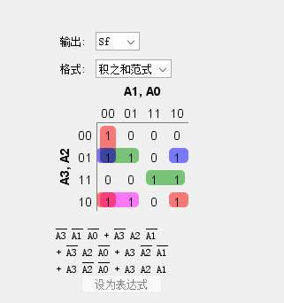
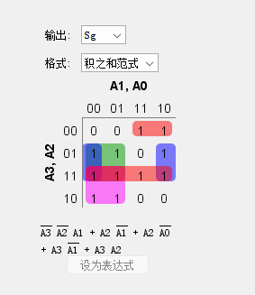
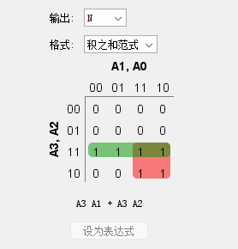
Design Progress—— K-Map

Slide 11
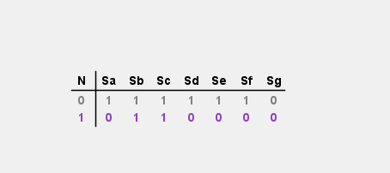
Design Progress—— Truth Table

Slide 12
Thank you

